Slide 1
MATHEMATICS
UNIT 1

Slide 2

Teacher Introduction
Notes:
Teacher introduces themselves and gives a little background information to personalise the welcome.

Slide 3
Mathematics Courses offered
Fundamental Maths Unit 1 & 2
Fundamental Mathematics has been designed to cater for students to develop strong numeracy skills across areas of mathematics that have links to tertiary studies with a “business” focus or to studies where strength in numeracy opens up a range of opportunities.
Mathematics Unit 1 & 2
Mathematics has been designed to cater for a wide range of student needs and is a prerequisite for some University courses. The subject will provide students with a broad range of mathematical knowledge and skills which will prepare students for a variety of University courses.
Advanced Maths Unit 1 & 2 (must be studied with Mathematics 1 & 2)
Those students who wish to undertake tertiary courses involving a significant amount of Mathematics should take Advanced Mathematics in conjunction with Mathematics.
Notes:
Hand out maths brochure to students. Briefly discuss the differences between the mathematics topics just to ensure students have chosen Mathematics Unit 1 correctly.

Slide 4
Diagnostic Test
Used to measure prior knowledge
Content includes pre-requisite knowledge of algebra, geometry, and number skills as well as skills that will be taught in the course.
Test will take 40 minutes
No calculator
Multiple choice and short answer.
Grade does not count towards overall result
Only complete questions you know and understand.
Try your best as additional work (the adaptive task) will be assigned to students who perform poorly.

Slide 5
Assessments
Engagement/Participation (ongoing) – 10%
Progress Test– 5%
Language Task – 5%
Study Area Tests – 30%
2 x 50 minute tests (15% each)
Tests will include multiple choice and problem based questions
Group Task – 20%
Two 1 hour supervised group sessions and a 1 hour supervised individual session
Exam – 30%
2 hour exam + 15 minutes reading time

Slide 6
Course Frameworks
Learner progression
Assessment as, for, and of learning
Graduate attributes
Integration of language skills and outcomes
Engagement/participation in group activities, investigations, and discussions
Online learning enhancement (blended learning) …
Notes:
Define each framework except for online learning as it will be explained in the next two slides.

Slide 7

What is Blended Learning?
Notes:
You may go to next slide before video finishes.

Slide 8
What is Blended Learning?
Notes:
You may go to next slide before video finishes.

Slide 9
Blended Learning
Pre-class: (prepares for the next lesson) This may include vocabulary, preparing notes, completing questions for necessary pre-requisite knowledge.
In class: (delivery of new content) Outcomes for the lesson are listed with suggested classroom activities. Lesson begins with a follow-up from previous lesson and the pre-class activity.
Post-class: (consolidation and practice of knowledge) Assigned by the teacher and may include textbook homework, online quiz, worksheets, forums, etc.
It is essential to complete pre-class tasks before each lesson, as it is assumed knowledge and the starting point for the next lesson.

Slide 10
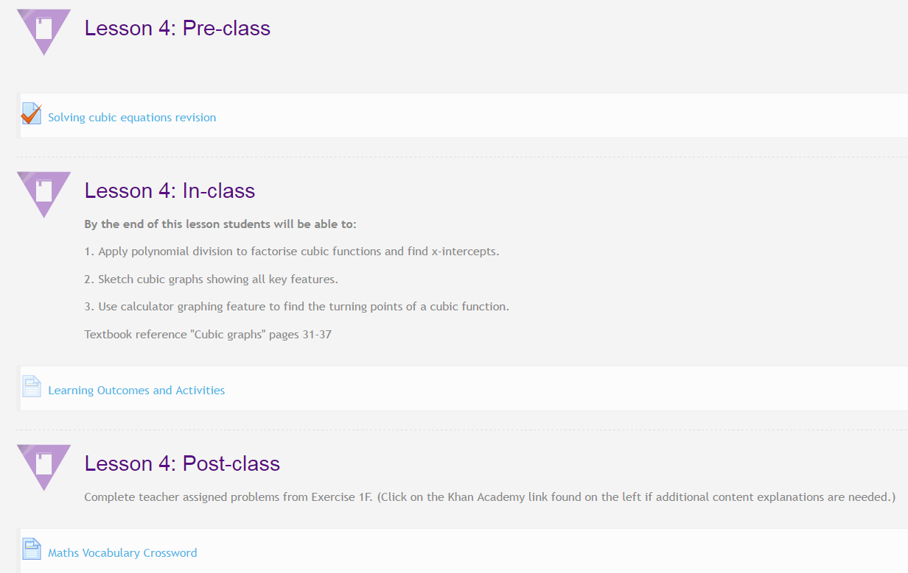
Notes:
Highlight key points mentioned in previous slide.

Slide 11

Course Page Scavenger Hunt
Now it’s time for you to explore the online learning page.
Working with a partner, answer the questions on the Scavenger Hunt worksheet.
You will both need to be logged into your account when completing the online tasks as all online activity is monitored and recorded for your engagement/participation mark.
If you need help, ask your teacher.
Good luck!
Notes:
Hand out Scavenger Hunt worksheet to students. Each student should have their own sheet. You will need to help them get online and on the correct page before pairing up and starting the activity.

